Slide 1
mechenance
Predictive maintenance & Sustainable manufacturing
dashboard
Team 3
Robert Kaczur, 101014890
Harsh udaybhai bhatt, 101478033
Rahul ., 101418100

Slide 2
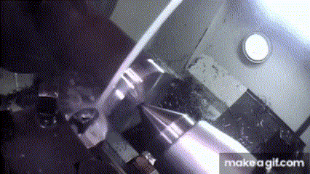
Did you know?
Total 18000 amputations, lacerations, crushing injuries, abrasions and around 800 deaths of workers happen every year in the manufacturing or heavy industries.
One of the top reasons is IMPROPER MAINTENANCE of machines.

Slide 3
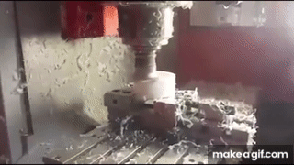
Why predictive Maintenance?
Injury: Facilities with poorly maintained equipment have been found to experience a higher rate of industrial accidents. For instance, OSHA highlights that proper maintenance can prevent up to 70% of machine-related accidents.
Downtime and Efficiency: A study by the Federal Emergency Management Agency (FEMA) indicates that predictive maintenance can reduce the probability of sudden equipment failures by up to 75%, consequently decreasing the risk of accidents associated with emergency breakdowns.
Cost: Research suggests that predictive maintenance can save companies 8% to 12% over preventive maintenance, and up to 40% over reactive maintenance strategies. This cost efficiency also helps allocate more resources to comprehensive safety measures.

Slide 4
Agenda
Introduction
Problem
Solution
Cost/Benefit Analysis
Business Case
KPIs
Literature Reviews
ML Canvas
Model Training & Benchmarking
Deployment
Demo / Proof of concept

Slide 5
Problem Statement
Companies spend millions of dollars in reactive maintenance (happens after failure) rather than predictive maintenance (happens before failure).
Companies lose time and productivity, or major accidents occur due to poorly maintained machines.
Manufacturing industries (or any other heavy industries) ignoring the environmental aspects of their business or unknowingly creating adverse effects on environment which leads to unsustainable way of growing business.

Slide 6
Solution
Dashboard indicating the probabilities of machine failures based on data collected from sensors.
Carbon footprint calculator for the users to run their business in sustainable way and in align with government policies.
Why: To save millions of dollars spent in reactive maintenance & increase productivity in manufacturing industries.
How: Leveraging the power of AI to analyze the sensor data and predict the probabilities of machine failures & predicting carbon footprint.

Slide 7

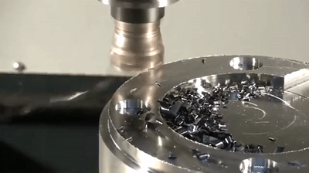
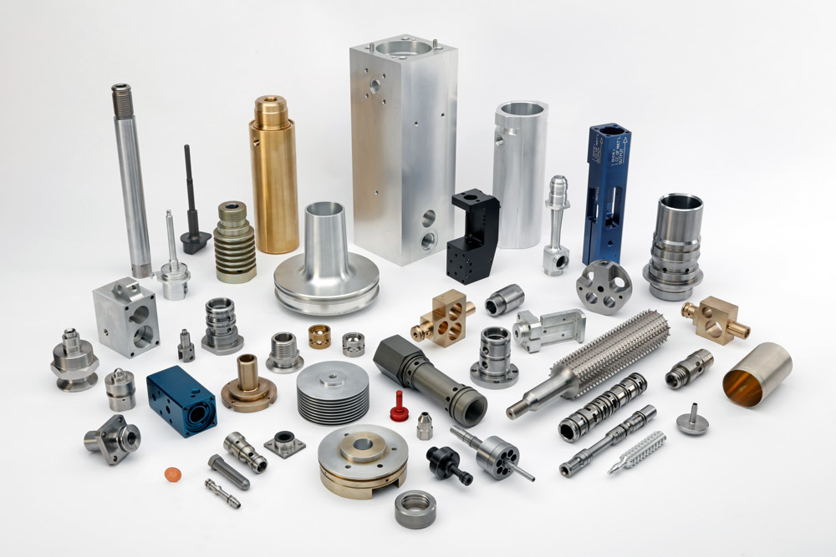
Project scope: CNC machine
Uses Computer Numerical Control (CNC) to remove material from workpiece to create custom designs.
Applications: Aerospace, Automotive, Medical Device Manufacturing, Electronics ,etc.
Types of failures:
Power Failure – due to increased air temperature.
Overstrain Failure – due to excessive rotational speed or torque.
Heat Dissipation Failure – due to increased air temperature or process temperature.
Tool Wear Failure – due to rotational speed and torque or running the machine for too long.

Slide 8
Business case: Strategic
Goals of any manufacturing business
Increase productivity
Minimize maintenance time
Minimize maintenance cost
Optimize the use of all machines and tools
Our model & dashboard can predict the failure beforehand with 86% accuracy.
On average, with 5-10% reduction in unplanned downtime can save up to $500,000 per year.
Competitive Analysis:
McKinsey reported that predictive maintenance can generate substantial savings by increasing production line availability by 5 - 15% and reducing maintenance costs by 18 - 25%.

Slide 9
Business case: Commercial
Strategic Partnerships
Collaboration with equipment manufacturers.
Integrating with existing industrial IoT platforms.
Partnering with sustainability-focused organizations
New collaborations will help drive sustainable business practices and create a more efficient and effective industry.

Slide 10
Business case: financial
Implementation Costs
Return of Investment(ROI)
Financial Projections
Implementation cost can vary for a pilot project with 1-5 machines to the scaled project with >20 machines. (Assuming the mid-size manufacturing industries).
ROI formula: (Total savings - Implementation costs) / Implementation costs. Increasing savings can increase ROI.
Reduced maintenance cost can increase annual savings and revenue.

Slide 11
Business case: management Implications
Stategic Alignment
Organizational Impact
Emphasize how the solution aligns with key strategic initiatives, such as digital transformation, sustainability, and operational excellence.
Organizational readiness assessment: Evaluate the company's capacity to adopt and integrate new technologies and workflows. And Identify potential challenges for employee engagement and training

Slide 12
KPI
Maintenance / Operational KPIs
Number of True Positives (Prevented Maintenance)
Machine life expectancy
Machine availability
Machine reliability
Reduction in unplanned downtime
Reduction (%) in spare part inventory & wastages
Sustainability KPIs:
Reduction (%) in energy consumption
Reduction (%) in carbon emission
Financial KPIs:
Reduction in maintenance cost
Cost saved by reduced unplanned downtime
Reduction (%) in labor cost

Slide 13
Cost benefit analysis
Cost
Hosting VM | $30/month
Storage | $2/month
Labor cost | $12/device
RTX 4090 (GPU Cloud) | $0.74/hour
Prediction | $0.10/1000
Benefit
Reduction in maintenance cost (Annually) (Increased Revenue (Savings)) | 18 To 25 % $25,000 (For $100,000 revenue) (Ref)
Increased Productivity (Profit) | 20 to 25% (Ref)
Decrease in machine downtime | 25 to 30% (Ref)
Increase in worker's safety | -
Energy saving in properly maintained machines. | 10 to 20% (Ref)
Example | 6 devices
Hosting | $30.00
Storage | $10.00
Labor cost | $72.00
Training | $532.8
Predictions | $1555.2
Estimate Monthly Cost
$2200
* Assuming 24 * 7 operations

Slide 14
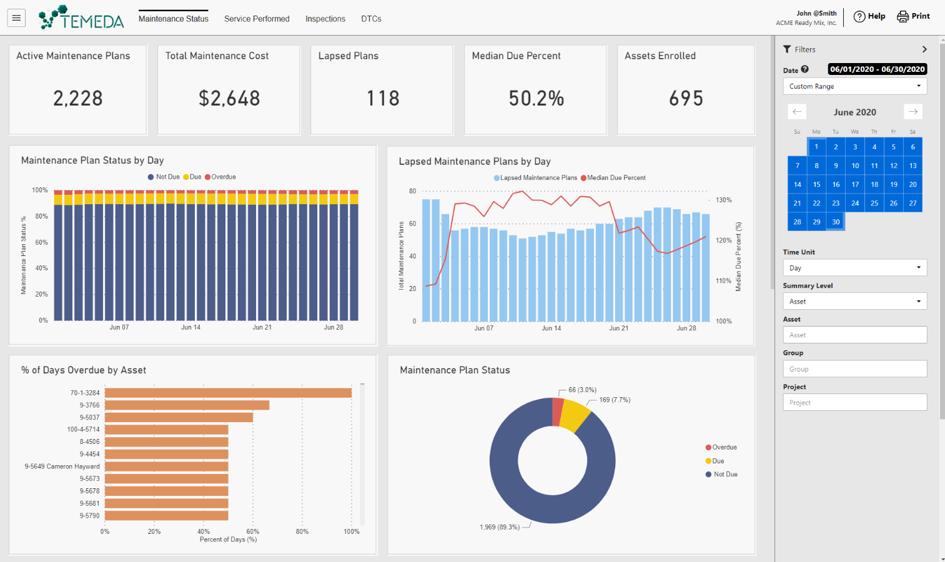
Literature review
Companies providing predictive maintenance services.
Temeda – Industrial IoT Dashboards (Link)
Saviant – Predictive Analytics (Link)
KCF Technologies (Link)
Emprise Corp. (Link)
Other IoT Services:
Watson IoT Cloud
Oracle IoT Cloud

Slide 15
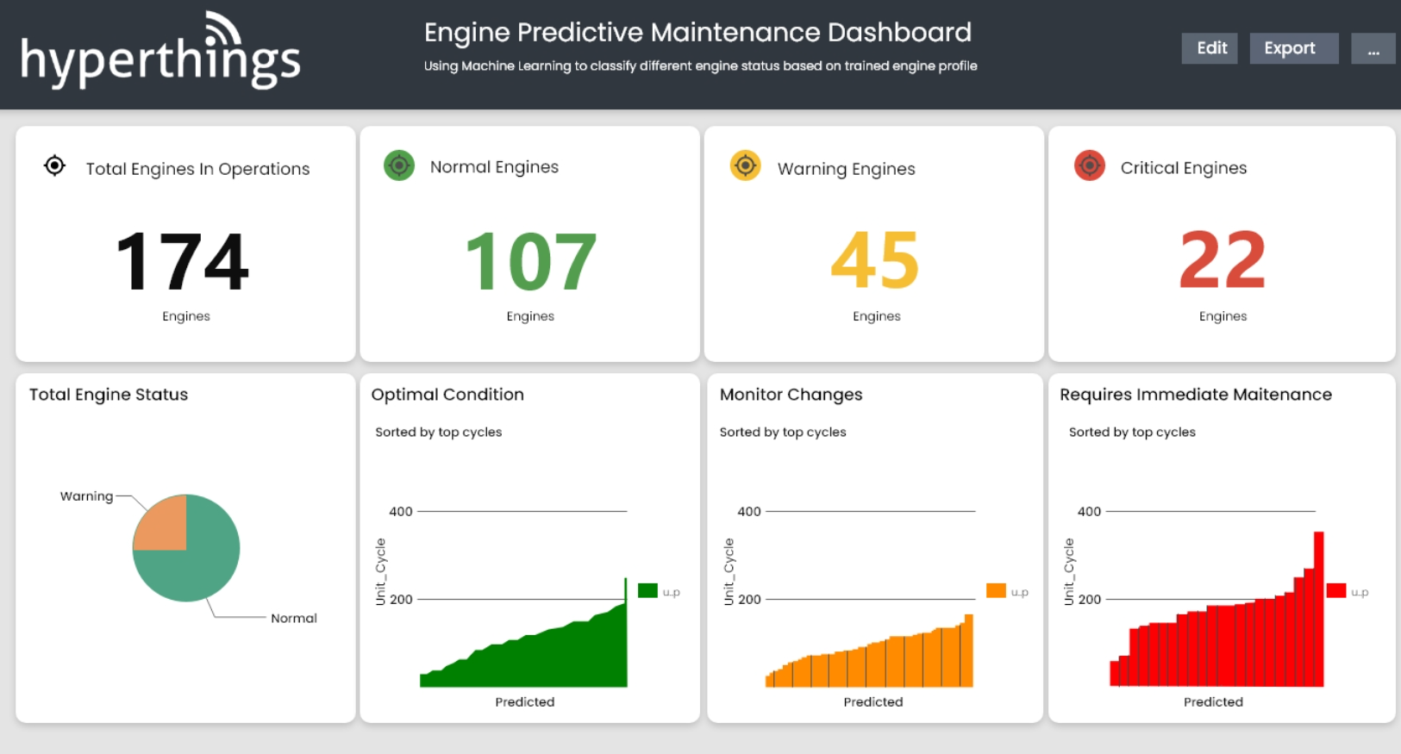
Literature review
Common Features in existing dashboards.
Machine / Tool Health Analytics
Maintenance Logs
Maintenance Intervals
Automated Maintenance Assignments
Inventory & Supply Chain Management

Slide 16
USP of mechenance
The unique features of Mechenance Dashboards apart from predictive maintenance are:
Insights of sustainable aspect of manufacturing.
Tracking and logging carbon footprint generated by machining.

Slide 17
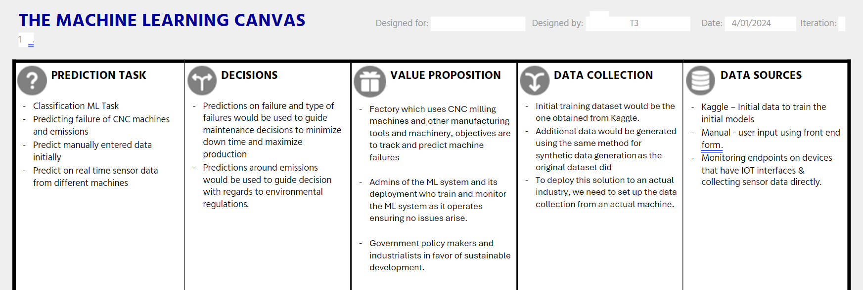
ML Canvas

Slide 18
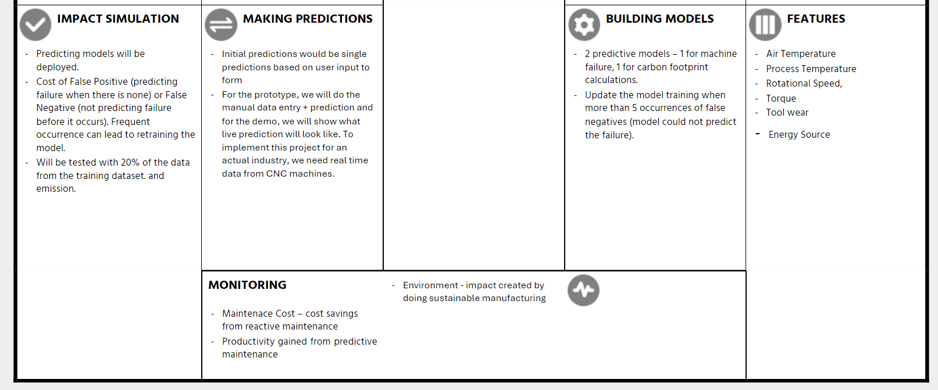
ML Canvas

Slide 19
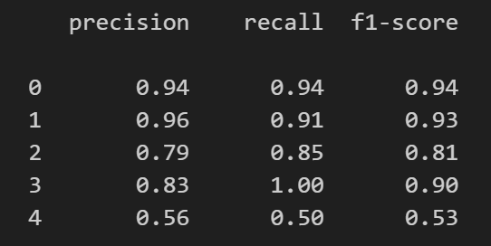
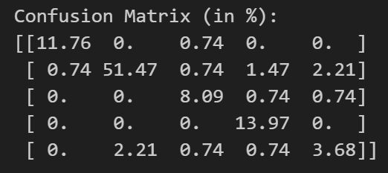
Model training & benchmarking
Steps for training:
Gathering data (Kaggle)
Loading the data in Notebook
Pre-processing
Removed NaN values
Balanced the data
Removed columns – Machine ID
Split the data into train-test (80-20)
Trained with Neural Network with Dense Layers
Testing with test data
Accuracy: 88%
Other Metrics:
Confusion Matrix:

Slide 20
Model deployment
2 Notebooks – Model 1 (Predictive Maintenance), Model-2 (Carbon Footprint Calculation)
Converted into 2 Python Scripts
Saved the models
Created 1 Python script to load the models and take input data to print the predictions
Converted into flask scripts, fast API script
Tested with Postman (Local)
Dockerization
Deployed (Tested with Heroku (Flask), GCP (Flask), GCP (Fast API)

Slide 21
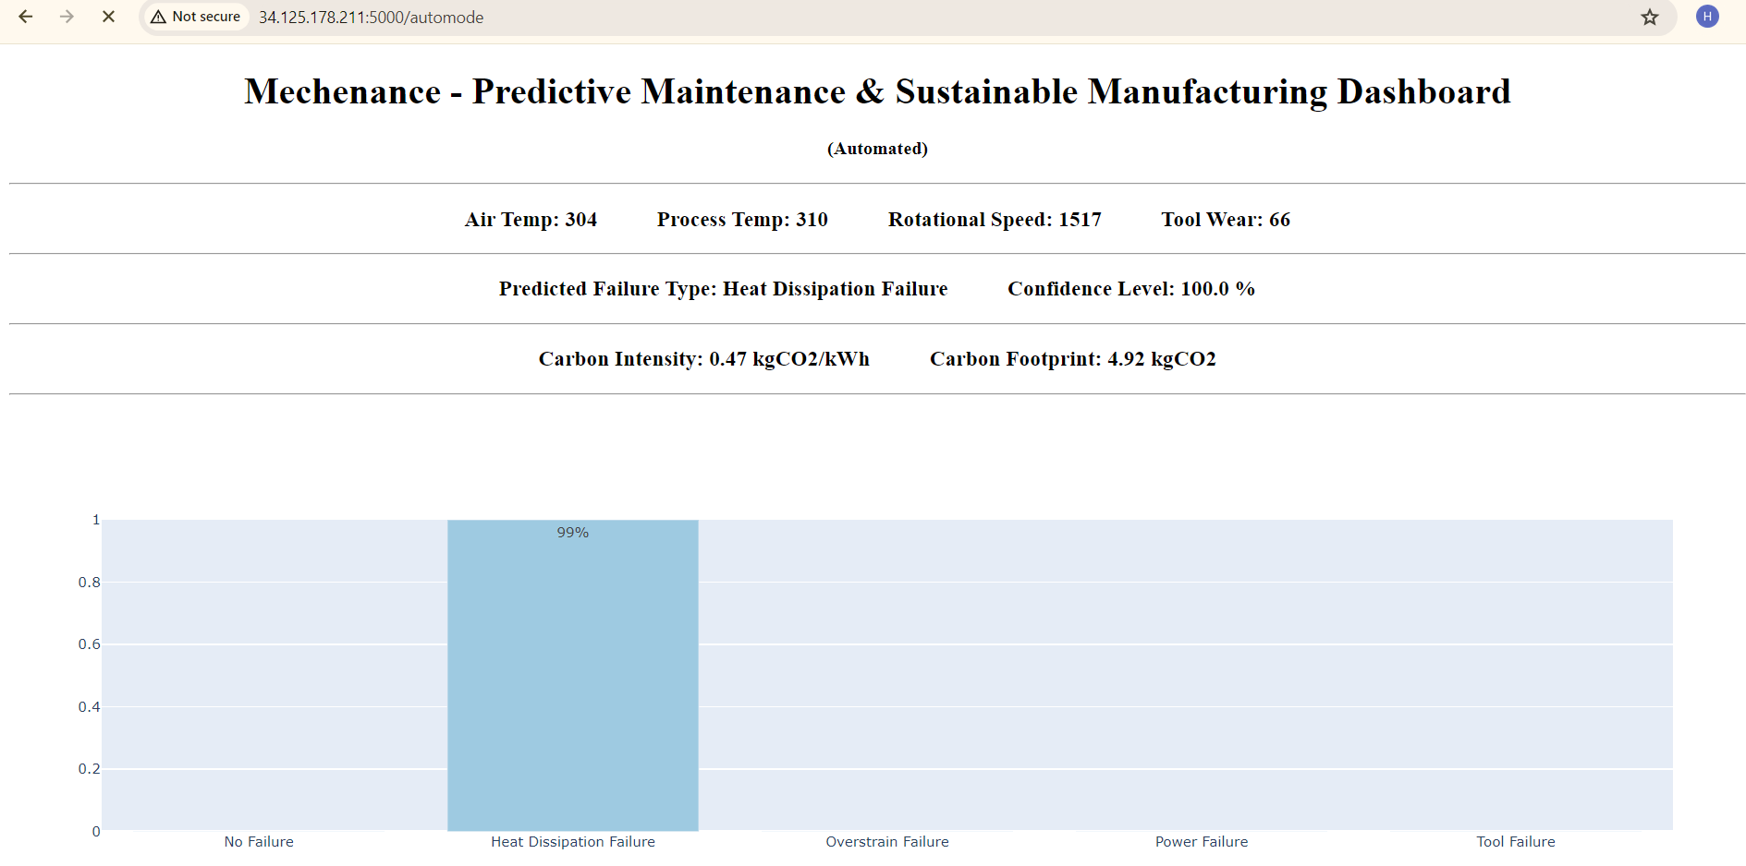
DEMO – VERSION 1 (GCP)
http://34.125.178.211:5000/
http://34.125.178.211:5000/automode

Slide 22
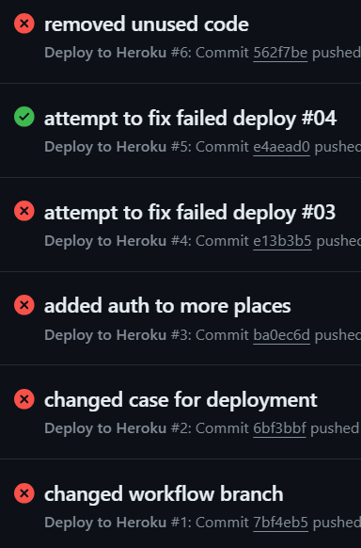
Challenges
Challenges | Solutions
Got errors of model not found while testing the docker locally. | Solved by modifying the docker script by including line to copy the 'models' folder in /app.
Managing database connection string. | Use environment variables and dot env files.
Memory error while creating docker. | Cleaned up the space locally.
Dependency hell | Better management of requirement file

Slide 23
Deployment Workflow and software stack
Development
Flask/FastAPI
Docker
Commit to repo
Github actions
Heroku/GCP
Tool | Purpose
Flask FastAPI | Server
Postgresql | Database
Docker | Containers
Heroku GCP | Deployment
Github actions | CD/CI

Slide 24
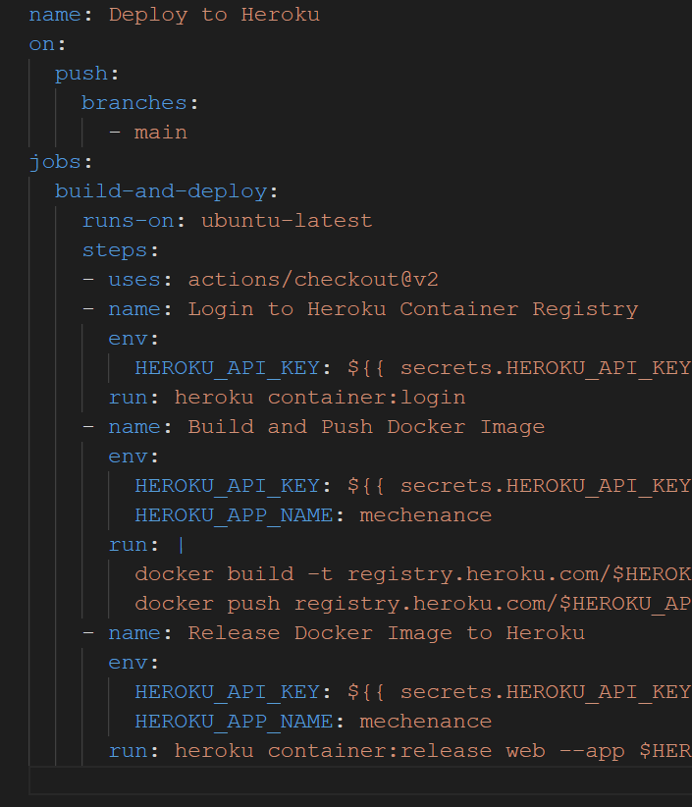
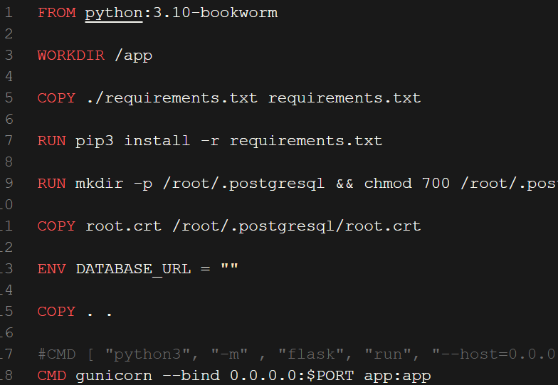
Dockerfile and github actions

Slide 25
DEMO
Link: https://mechenance-900ac7459385.herokuapp.com/

Slide 26
Range of values - Demo
Air Temperature (K): 298 - 304
Process Temperature (K): 305 - 310
Rotational Speed (RPM): 1000 – 2500
Torque (N-m): 10 – 65
Tool Wear (Min): 1 - 225

Slide 27
What's next
More models for different devices
Endpoints that can have devices send updates to.
Per device monitor with alerts and management
Emissions Reporting and feedback control to reduce emissions
Implement Training Routes

Slide 28
Thank you

Slide 29
Reference
https://www.researchgate.net/publication/257581417_A_quantitative_approach_to_analyze_carbon_emissions_of_CNC-based_machining_systems
https://www.sciencedirect.com/science/article/pii/S2666412724000035
https://www.theagilityeffect.com/en/article/how-predictive-maintenance-cuts-costs/
https://blog.isa.org/ai-and-predictive-maintenance-can-save-money-and-improve-production

